Slide 1
Lecture 9 - Feature Importance and Regularization
DS 4400: Machine Learning and Data Mining 1

Slide 2
Today
1 Today
Constraints
Regularization
Feature Importance
Practice
First Exam Topics

Slide 3
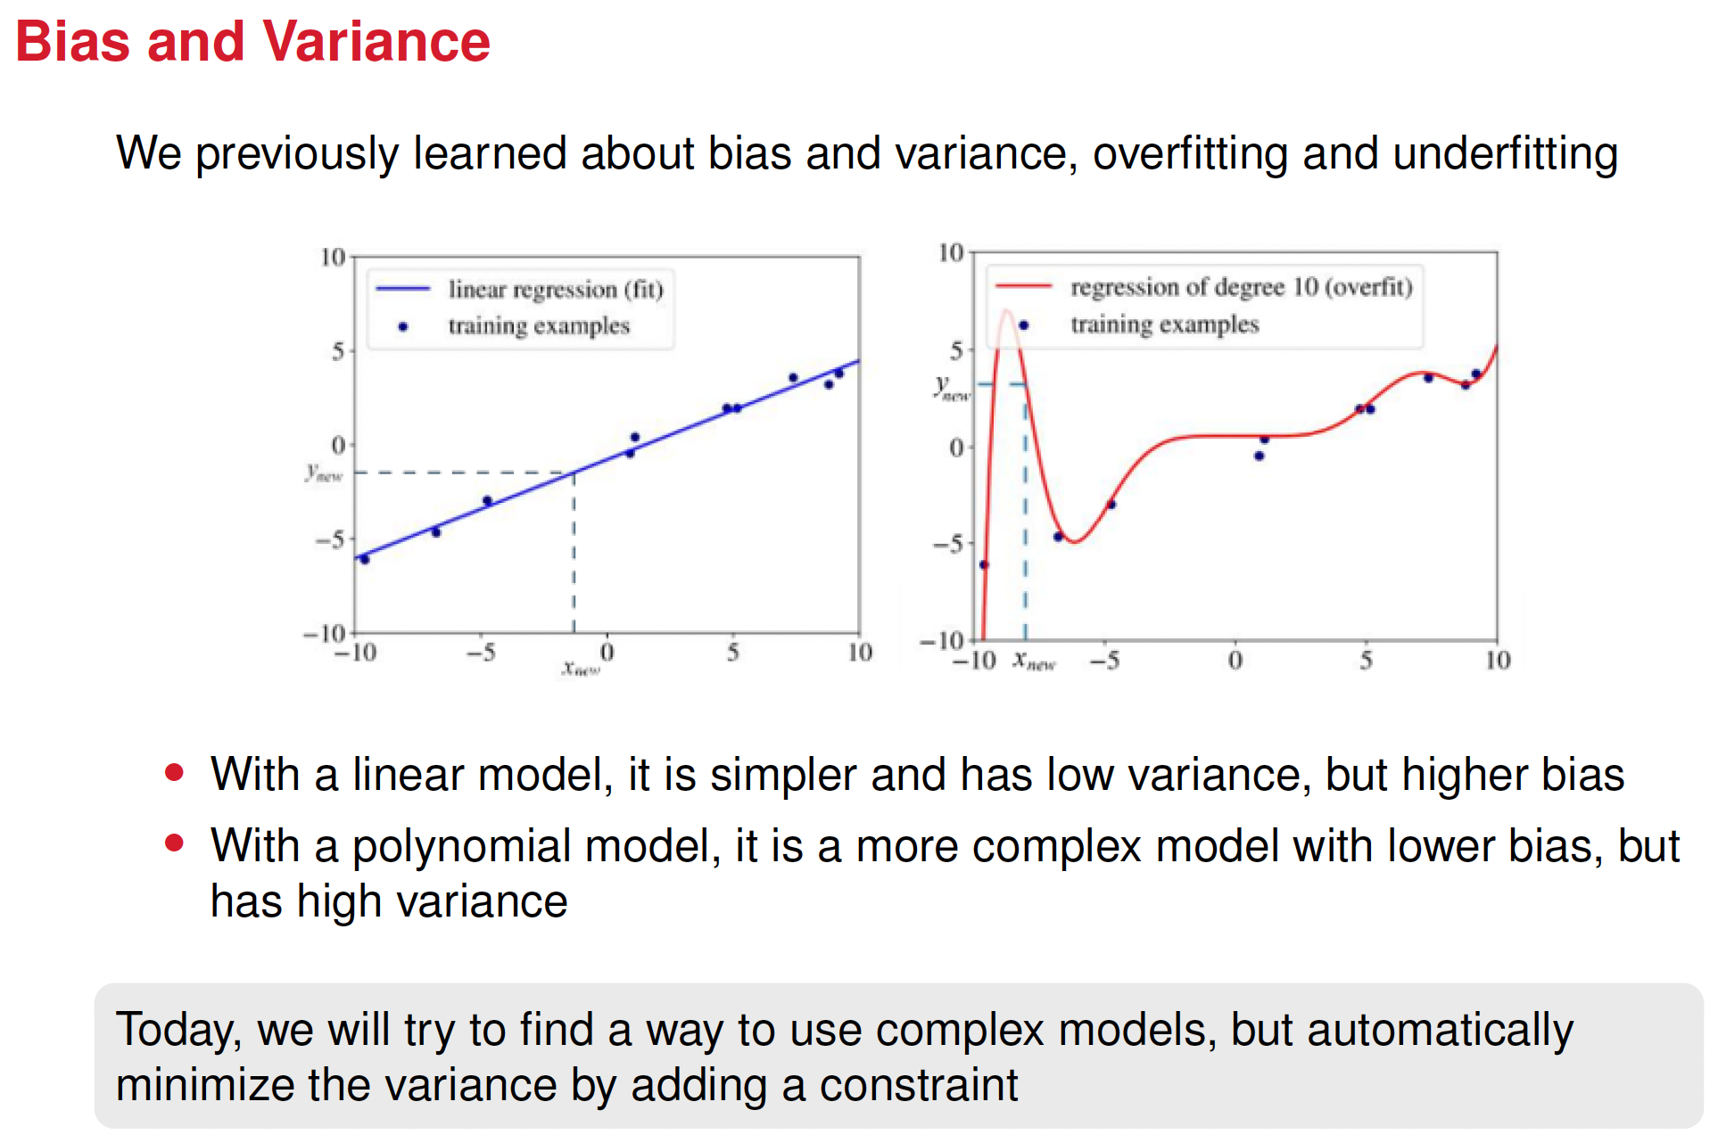

Slide 4
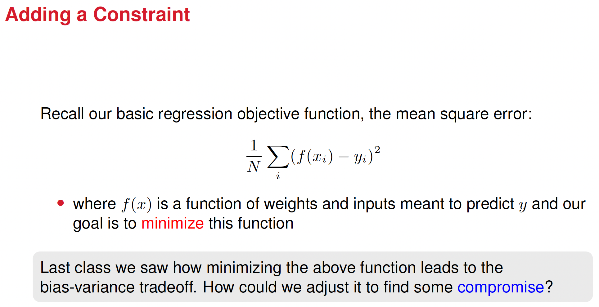

Slide 5
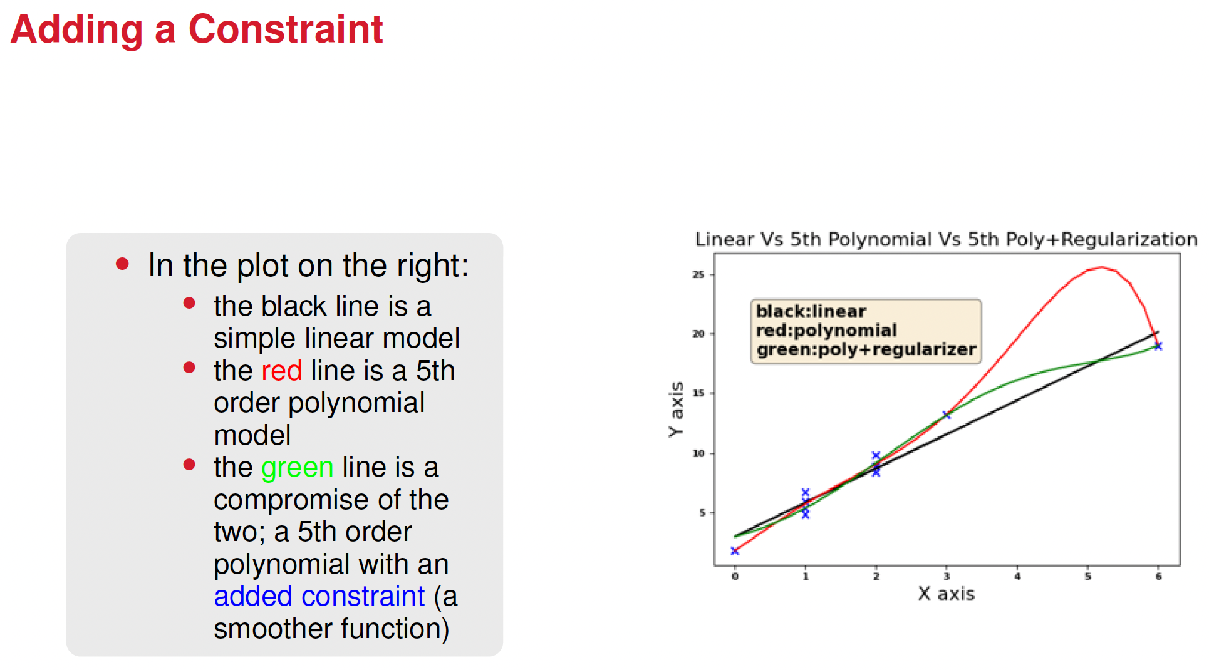

Slide 6
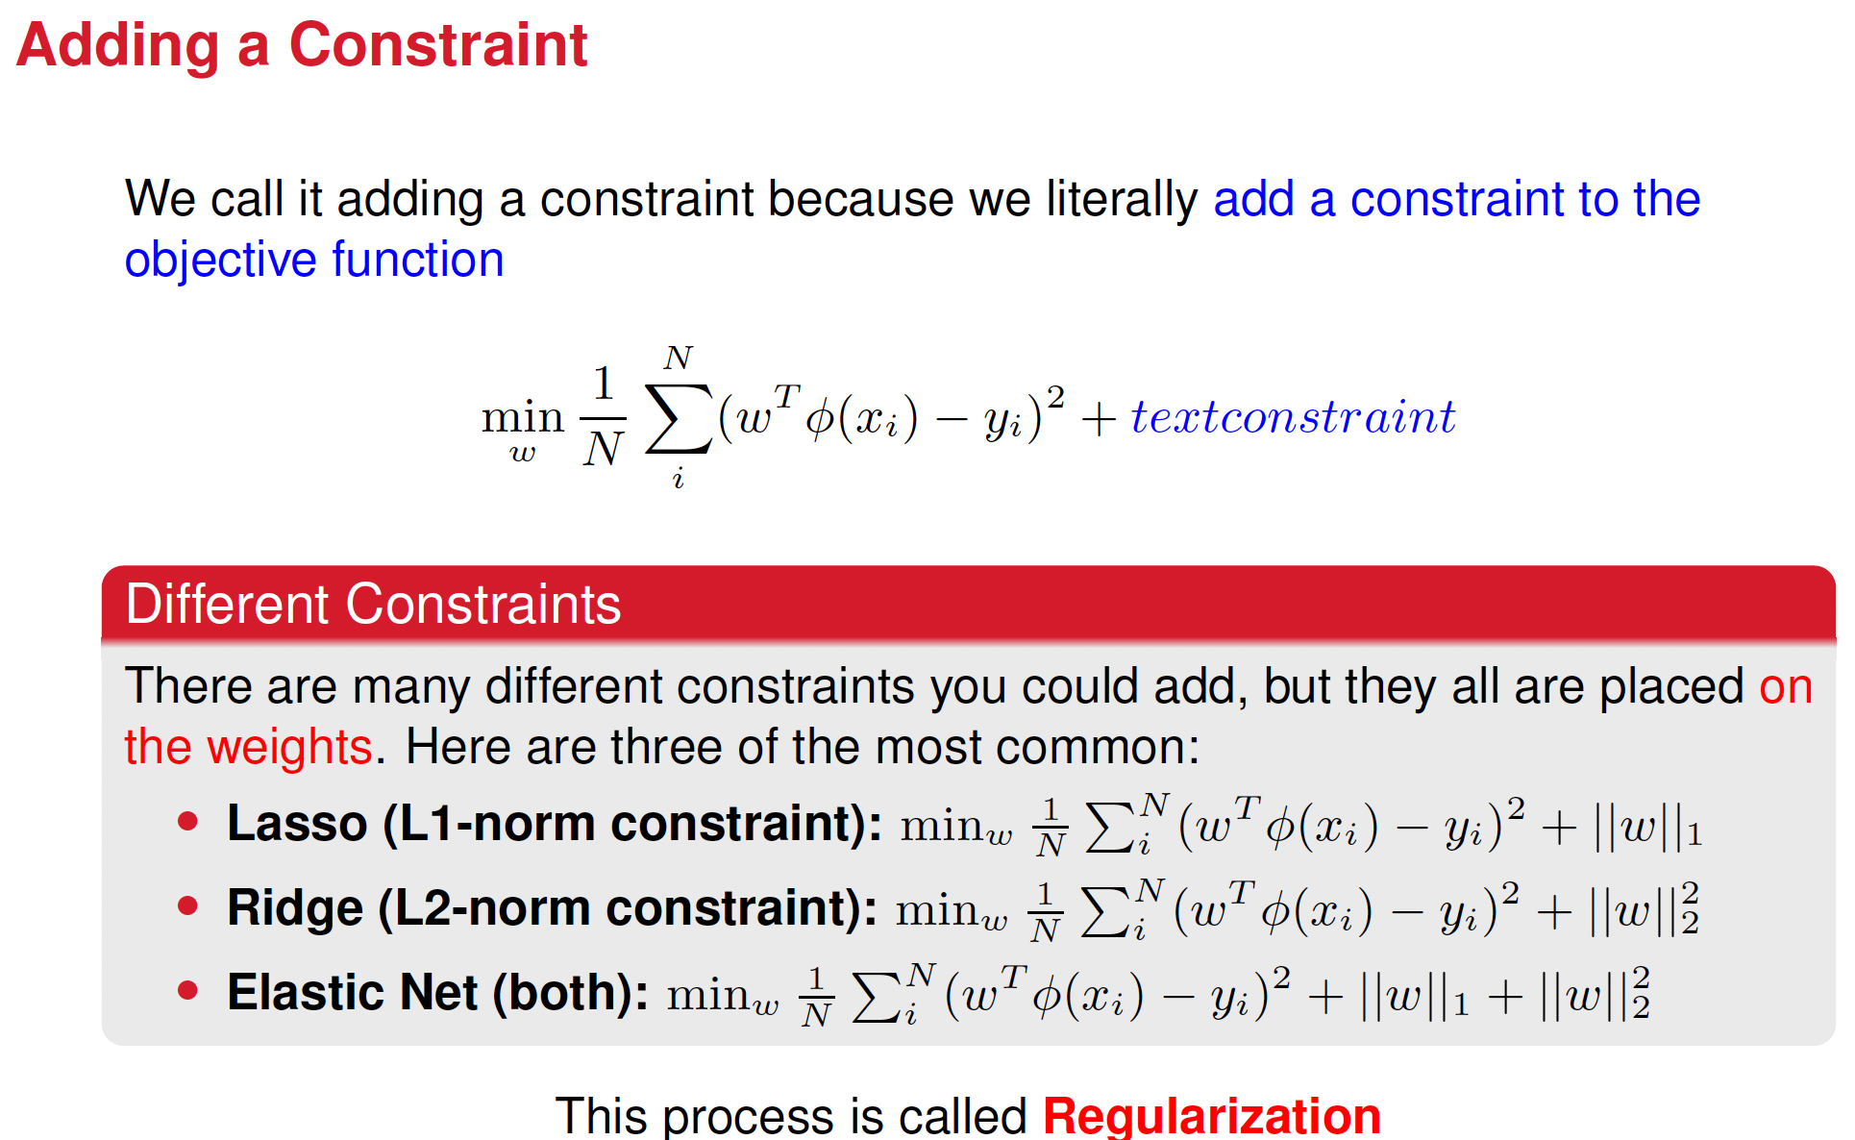

Slide 7




The "L1 norm" calculates the "length" of a vector by summing the absolute values of all its components.
Also known as:
"Manhattan distance" or "taxicab norm" because it represents the distance traveled in a city grid by only moving along axes.
Applications:
Feature selection in machine learning, where it encourages sparse solutions by prioritizing variables with larger absolute values.

Slide 8



The "L2 norm" calculates the "length" of a vector by taking the square root of the sum of the squares of all its components.
Also known as:
Euclidean norm because it represents the straight-line (Euclidean) distance between two points in space.
Applications:
Common in machine learning for regularization (e.g., Ridge regression) because it penalizes large weights smoothly, leading to models that generalize better by discouraging extreme values while retaining all features.

Slide 9





The "L∞ norm" calculates the "length" of a vector by taking the maximum absolute value of its components.
Also known as:
Maximum norm or Chebyshev distance because it represents the greatest absolute distance in any single dimension.
Applications:
Used in optimization problems to bound the largest error or ensure robustness by controlling the maximum deviation in solutions. It is particularly useful in settings where outliers or extreme values are critical.

Slide 10
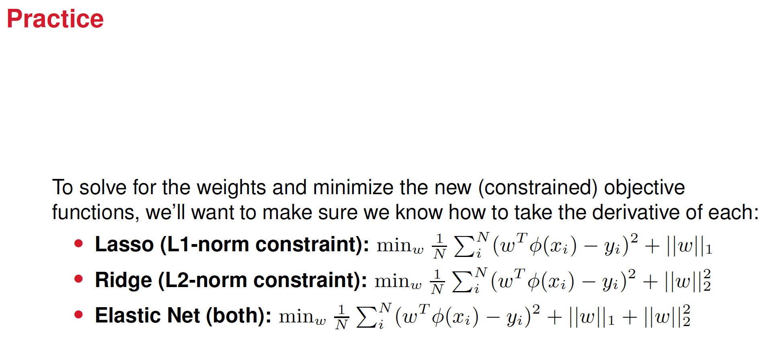

Slide 11
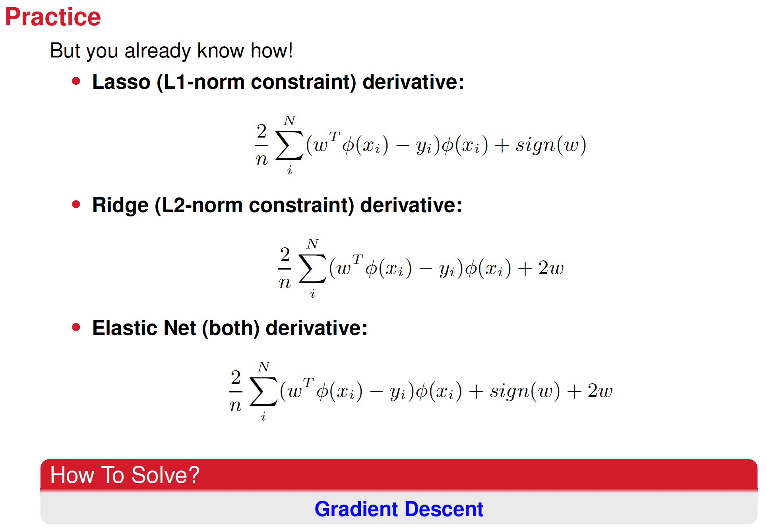






Slide 12







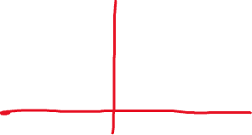







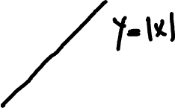



Explain the sign function

Slide 13
What Kind of Features Does Lasso Regularization Favor?
sparse solutions: selects a small subset of features while driving others to exactly zero.
Strongly Relevant Features:
Features that have a strong linear relationship with the target variable tend to be retained.
Lasso assigns larger weights to these features since they contribute the most to reducing the prediction error.
Non-Collinear Features:
If two or more features are highly correlated, Lasso often selects only one of them while driving the others to zero.
Sparse Representations:
If the true underlying model depends only on a few variables Lasso is particularly effective because it naturally selects those variables and discards the rest.
Interpretable Models:
By favoring fewer nonzero coefficients, Lasso helps in creating models that are easier to interpret, especially when dealing with high-dimensional data.

Slide 14
Why Is It Called Lasso?
The name Lasso stands for Least Absolute Shrinkage and Selection Operator:
Least Absolute → Refers to the use of the L1-norm (sum of absolute values of coefficients).
Shrinkage → Coefficients are reduced (shrunk) towards zero due to regularization.
Selection → Unlike Ridge Regression, Lasso can force some coefficients to be exactly zero, effectively selecting a subset of features.
Operator → It acts as an operation on the model to enforce sparsity.

Slide 15
What Kind of Features Does Ridge Regularization Favor?
Ridge regression (L2 regularization) does not perform feature selection like Lasso, but instead shrinks all coefficients smoothly. It favors
All Relevant Features (No Feature Selection)
Ridge does not force coefficients to zero but rather reduces their magnitude.
It retains all features but assigns smaller weights
Highly Correlated Features
When features are highly correlated, Ridge regression distributes weights among them rather than selecting only one (as Lasso does).
This makes Ridge a good choice when dealing with multicollinearity, ensuring that no single correlated feature dominates.
Small-Magnitude Weights
Ridge tends to shrink coefficients toward zero but never exactly to zero.
This is useful when all features contain some level of useful information, even if some are weaker predictors.
Models That Generalize Well
Since Ridge reduces overfitting by discouraging large coefficients, it works well when dealing with high-dimensional data where overfitting is a concern.
The term Ridge Regression comes from the concept of ridge lines in mathematics and optimization.

Slide 16
Why Is It Called Ridge?
Here's why:
Constraint Forms an Ellipse (Ridge Shape)
Ridge regression minimizes the sum of squared residuals plus an L2 penalty term, forming a ridge-shaped constraint in the optimization space.
The L2-norm constraint creates an elliptical contour around the coefficient space, unlike Lasso’s diamond-shaped constraint.
Avoiding Flat Regions (Ill-Conditioning Solutions)
In ill-conditioned problems (where predictor variables are highly correlated), the solution can be unstable.
The L2 penalty smooths the estimates and pushes them toward the ridge of the constraint, preventing extreme values.
Historical Naming
The term ridge regression was introduced by statisticians Hoerl and Kennard in the 1970s, emphasizing its effectiveness in handling collinear predictors.

Slide 17
Key Difference Between Ridge and Lasso
Lasso: Performs feature selection (some coefficients = 0) → good for sparse models.
Ridge: Shrinks all coefficients smoothly (none exactly 0) → good for multicollinearity and when all features matter.
That’s why Ridge is great when you want to keep all features but prevent large coefficients from dominating.

Slide 18
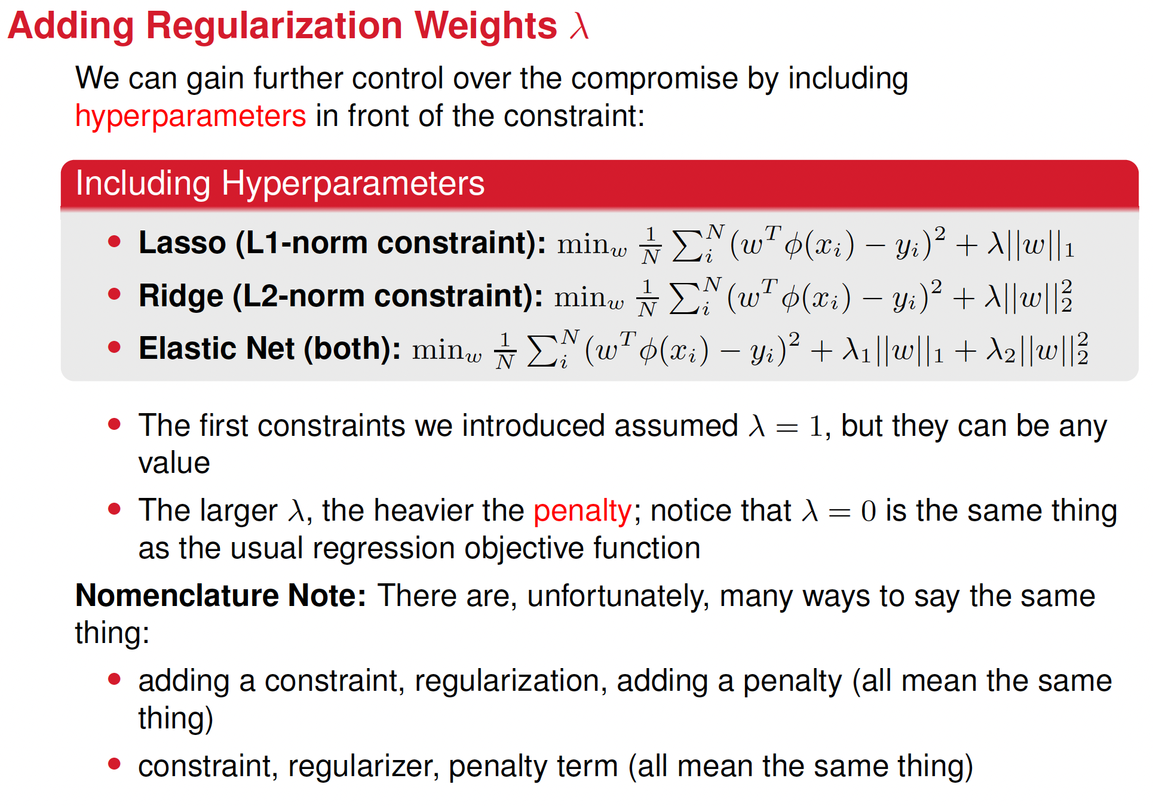

Slide 19
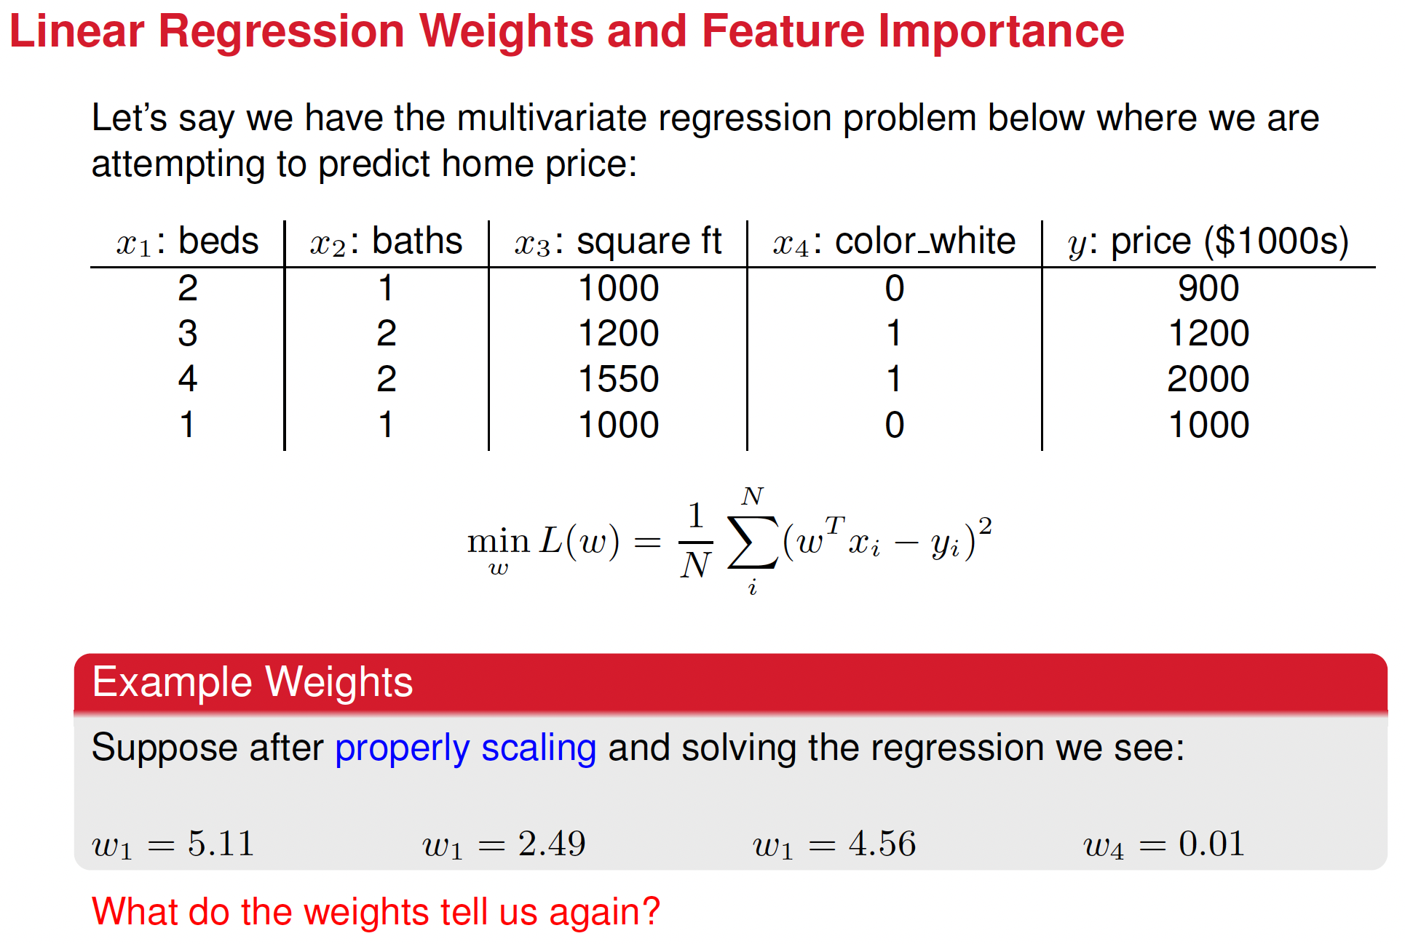



Slide 20
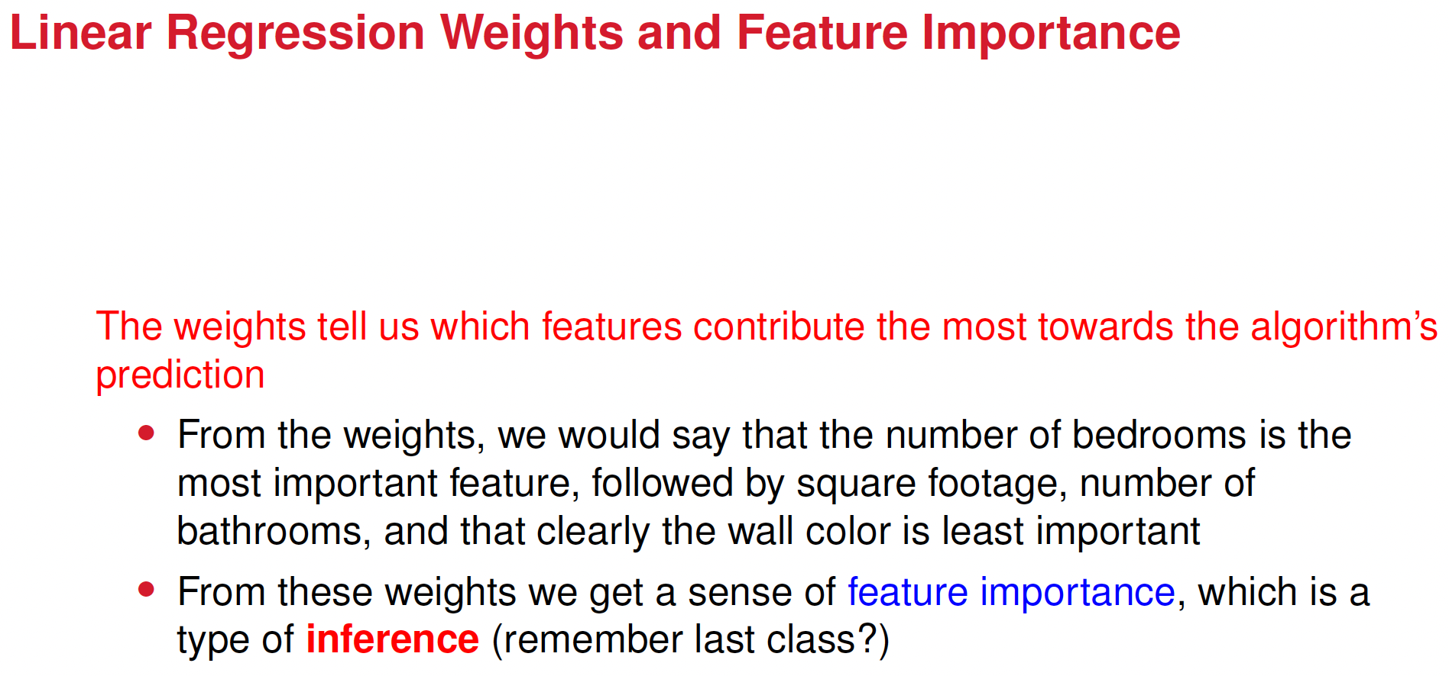

Slide 21
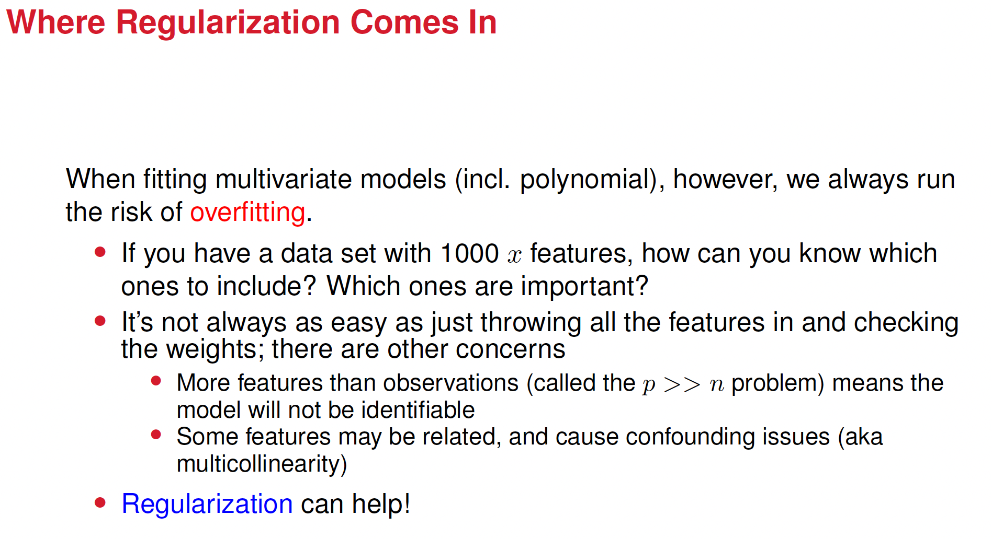

Slide 22
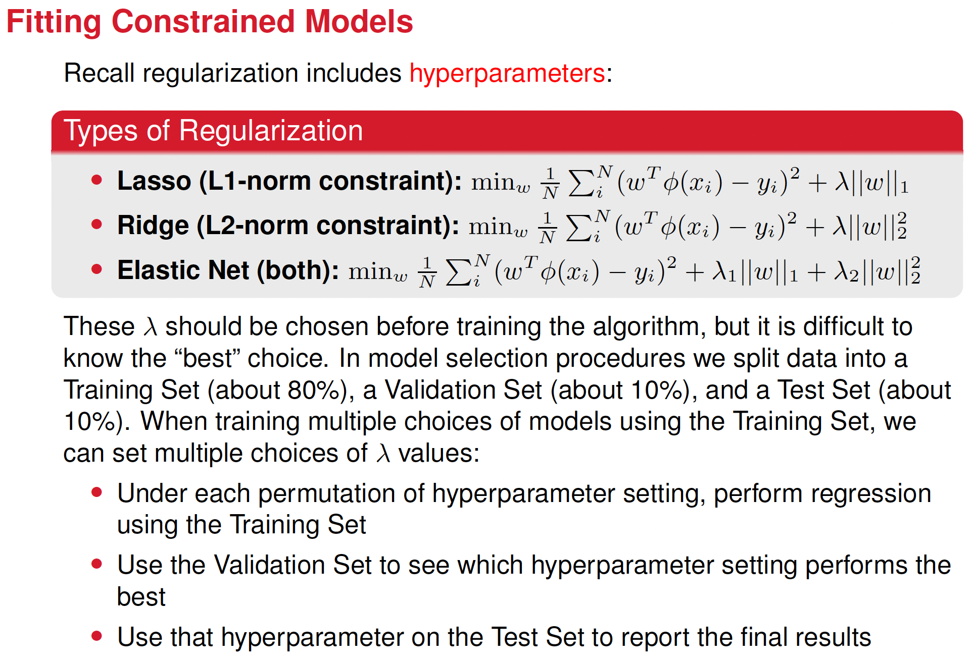

Slide 23
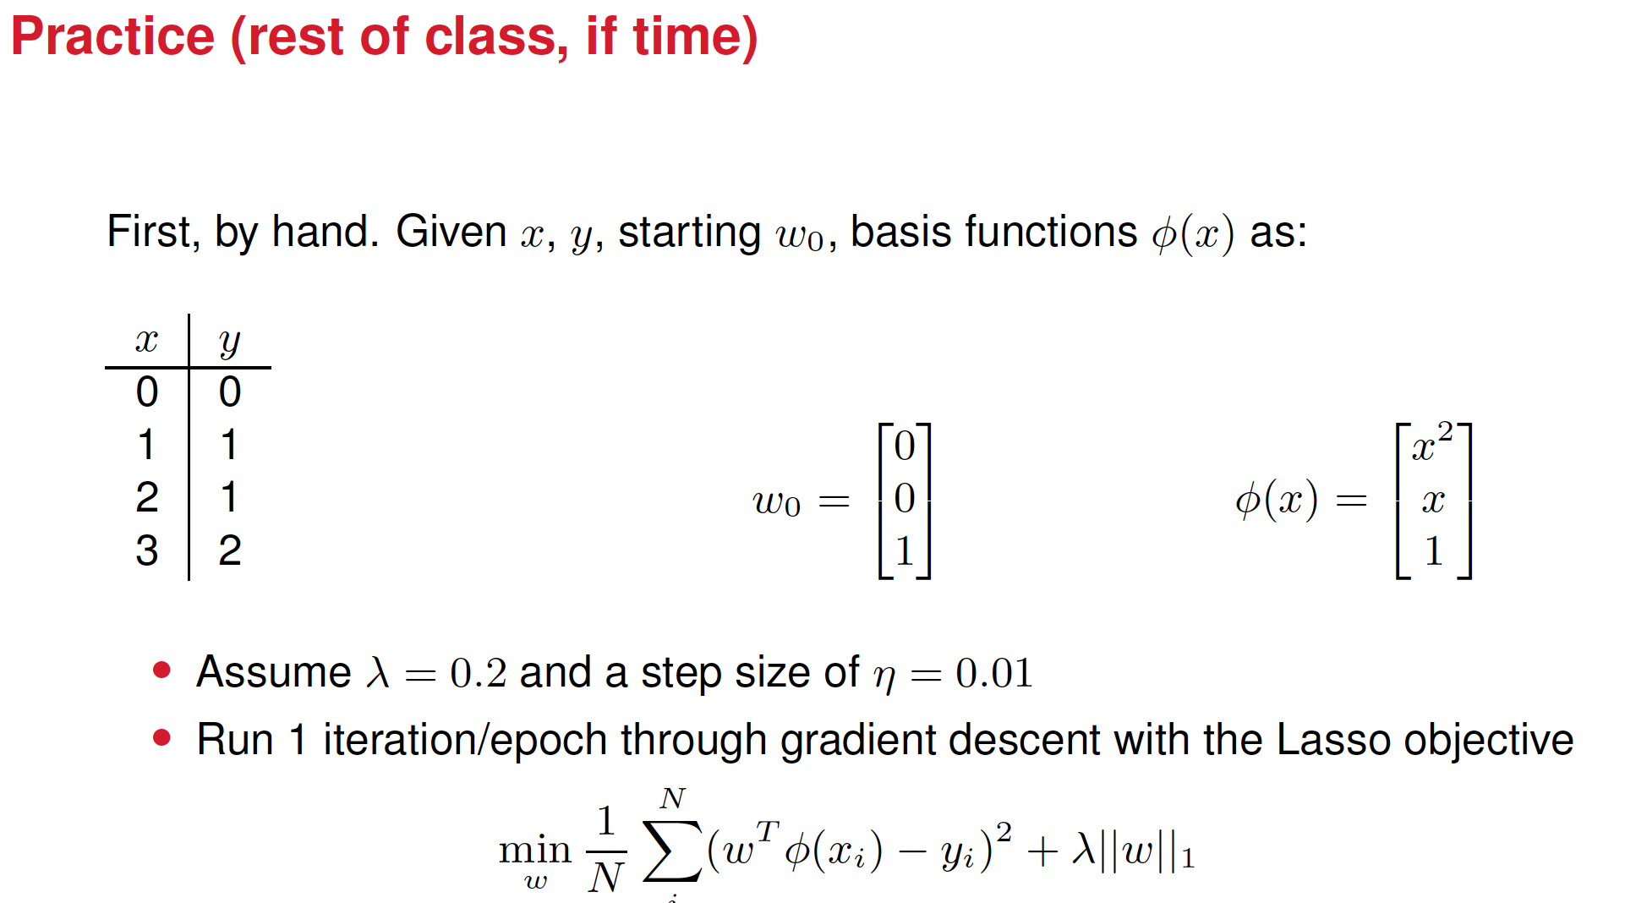

Slide 24
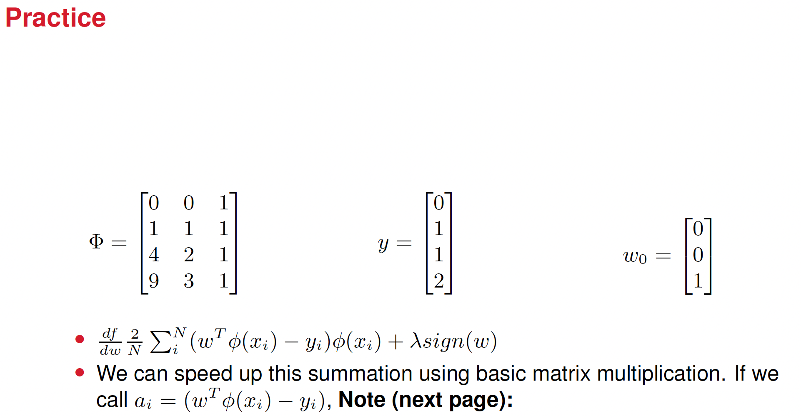

Slide 25
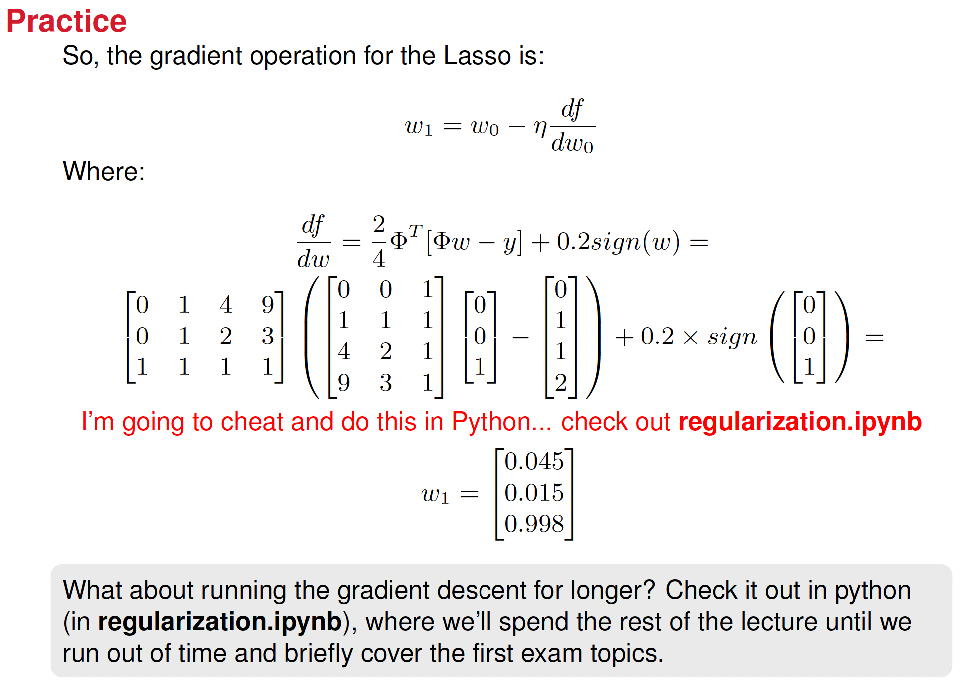

Slide 26
Topics for First Exams
In-Class Math
Taking derivatives and integrals
Matrix operations and norms
Minimizing objective functions using:
Gradient descent
Closed form solutions
Basic probability and statistical concepts
Hint: Make sure everything in Homework 0 through 3 makes sense

Slide 27
Topics for First Exams
Take-Home Coding
Matrix operations and norms
Minimizing objective functions using:
Gradient descent
Closed form solutions (may require some handwork)
Data pre-processing
Hint: Make sure everything in the .ipynb files on Canvas (up to and including
data preprocess.ipynb) makes sense

Slide 28
A cautionary tale:
an advice for when you start your project

Slide 29

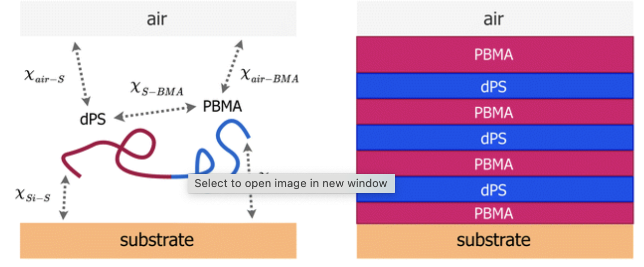
Searching for materials for making the batteries of Electric Vehicles (Evs)
Incoming neutron
Reflected neutron

Slide 30
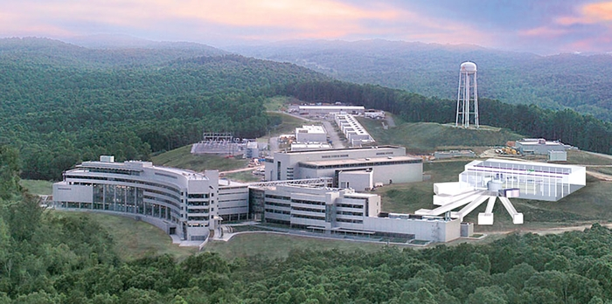
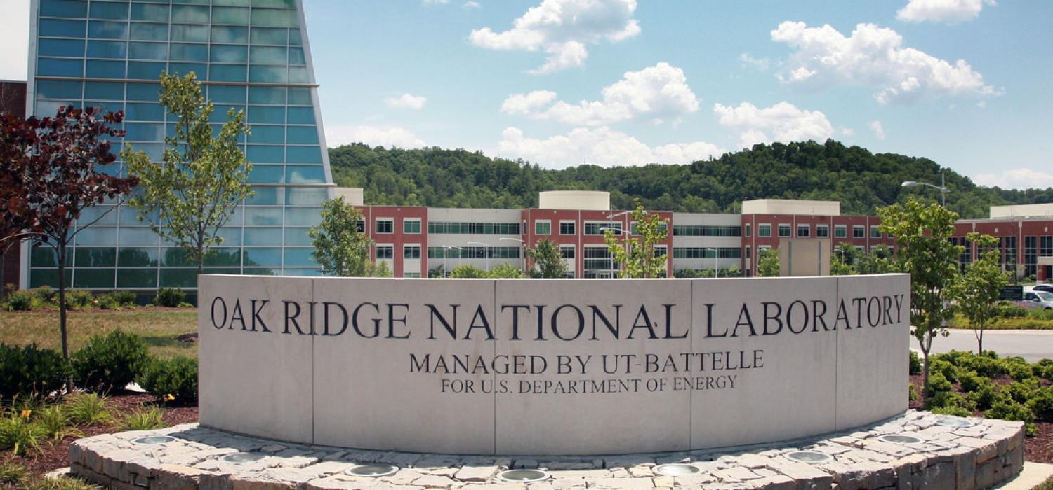
The neutrons are produced at the Spallation Neutron Source (SNS), at the Oak Ridge National Laboratory

Slide 31

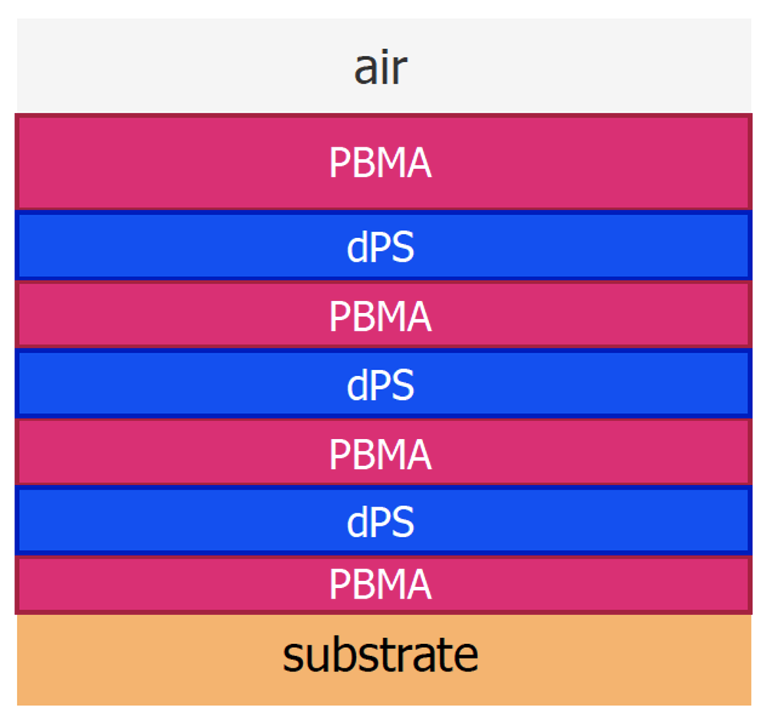
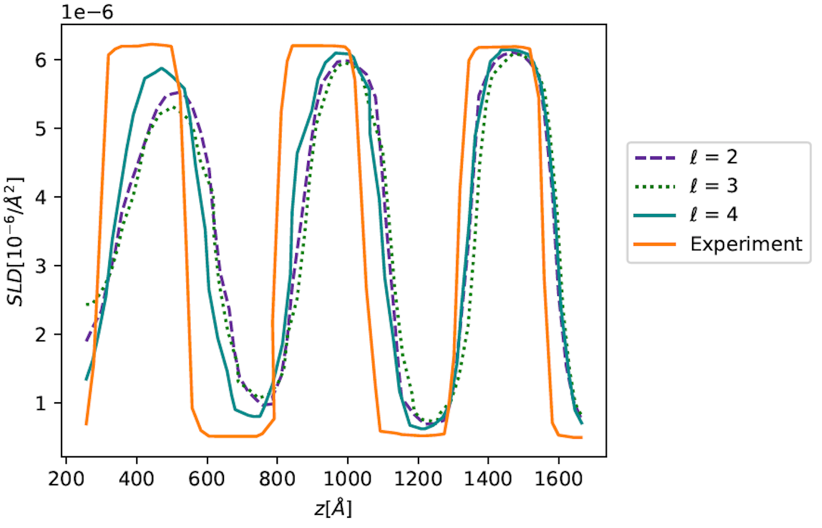
Our vision: develop a Machine Learning (ML) method that learns the relation between structure and neutron spectra.
structure
Neutron spectra
n
Notes:
So we’d like to make ML pipelines that can learn the relations both between structure and physical parameters, as well as between structure and reflectivity curves. A sufficiently capable model could both reduce time spent fitting curves as well as improve accuracy and capabilities.

Slide 32
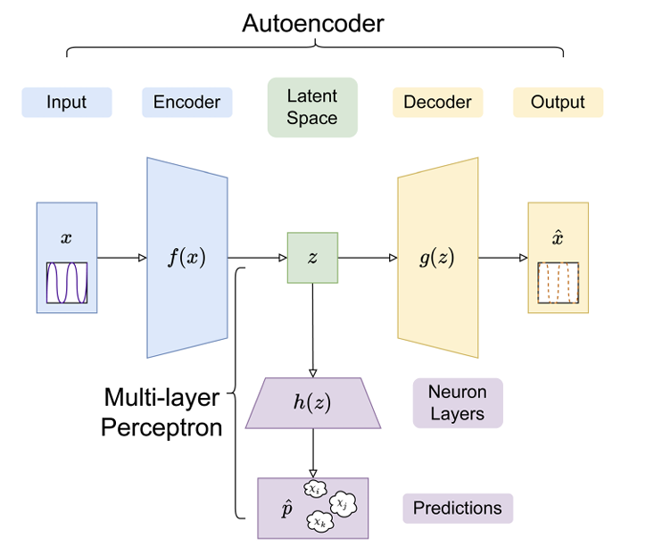
Autoencoder + Multi-Layer Perceptron

Slide 33
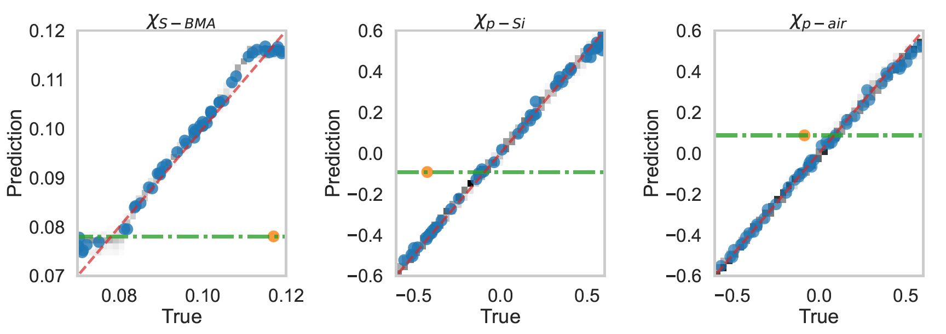
Results: predictions vs. True labels
Results: We started by training an MLP to SCFT SLD curves. Below are shown the predicted vs. ground truth χ

Slide 34
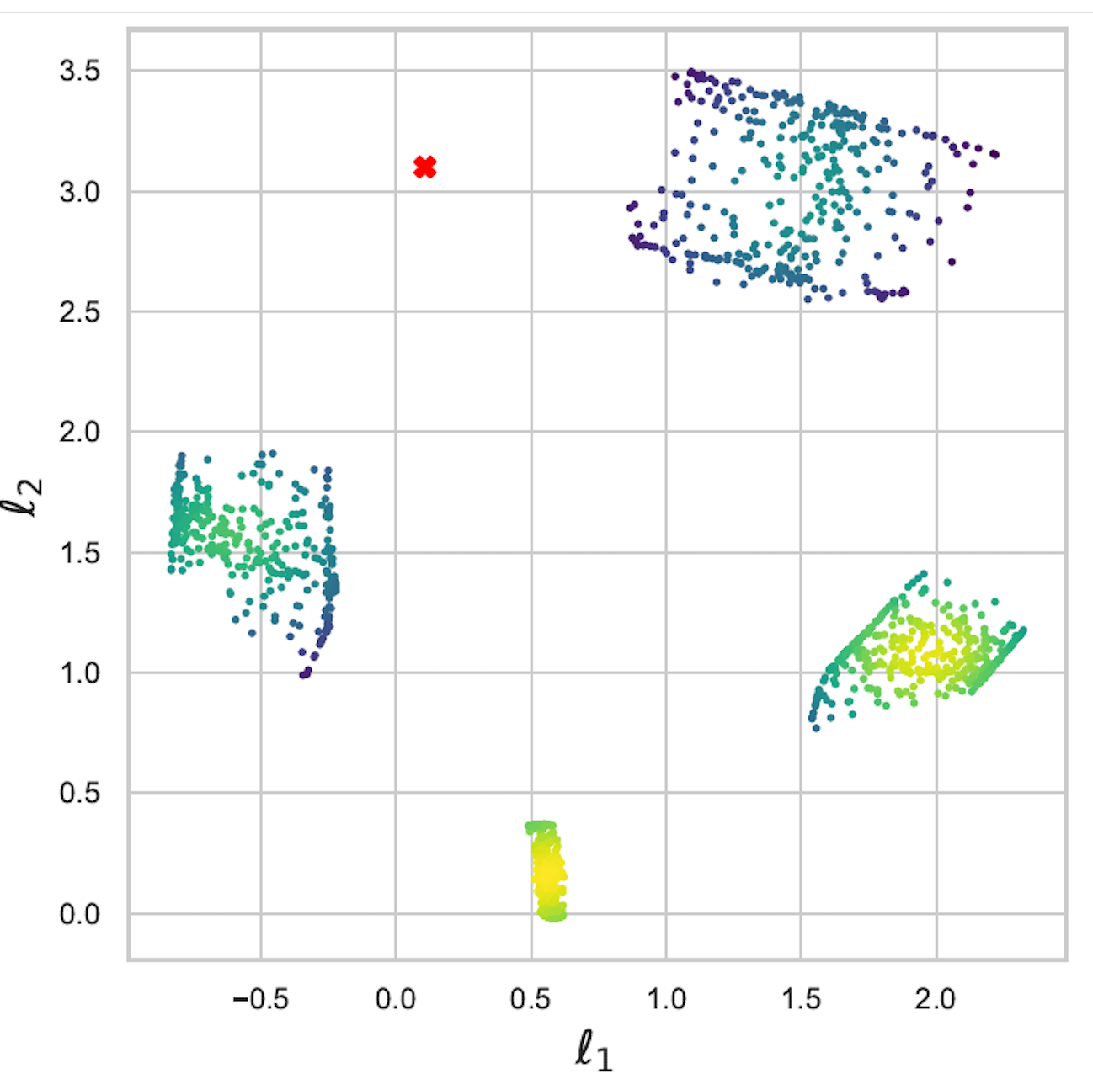
Why did it failed? because the experimental curve is out of the synthetic data distribution we used to fit our model

Slide 35
It failed because the experimental dot is out of the distribution of the synthetic data we used to fit our model

Slide 36

Our ML pipeline: Autoencoder + Multi-Layer Perceptron
Eby et al., Nanoscale 15, 7280 (2023).

Slide 37
Lessons:
First thing you should do in your project is analyze your data by:
Visualizing it (if you can)
Doing clustering, i.e. KMeans

